Slide 1

Mathematical Preliminaries
By:
Hrudhay Reddy (577833)
Morne du Plessis (577299)
Sinoyolo Londiwe Mabuza (577768)
Thorisho Serumula (578015)

Slide 2
Introduction
Given a particular problem, mathematical preliminaries are best utilised to calculate the optimal solution to any particular linear programming model. It can also be used to find the ranges and changes to a mathematical model’s objective function coefficient(s), constraint coefficient(s), or the constraints’ rights hand side.

Slide 3

G&J’s Local Shop
Grace and Jimmy own a local shop in Giyani that sells 2 fruits, namely dragon fruits and mangoes. They make a profit of R3 and R2 for each dragon fruit and mango box sold, respectively. Each dragon fruit incurs a R1 loss as they have to import them from Kruger National Park due to them having a high demand from their customers but not being able to grow in their part of the country.

Slide 4
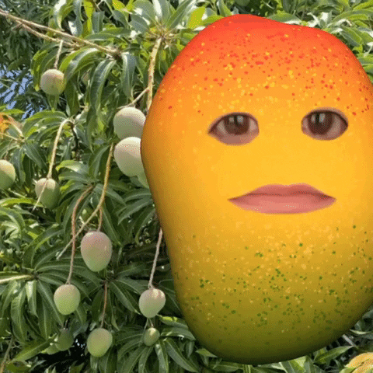
…Continued
Their shop ships to customers who live in Pretoria and the fruit boxes can only be shipped out for 1 hour (hr) and the imported dragon fruit for 3 hrs and they can be in shipment for a maximum of 5 hrs. A minimum demand of 2 orders is required for each box of mango and 2 boxes of dragon fruit being shipped out as 1 box of dragon fruit should be imported. In each box sold there should be 4 dragon fruit shipped out and 3 shipped in for each 2 dragon fruit shipped in; with an exact amount of 5 required

Slide 5
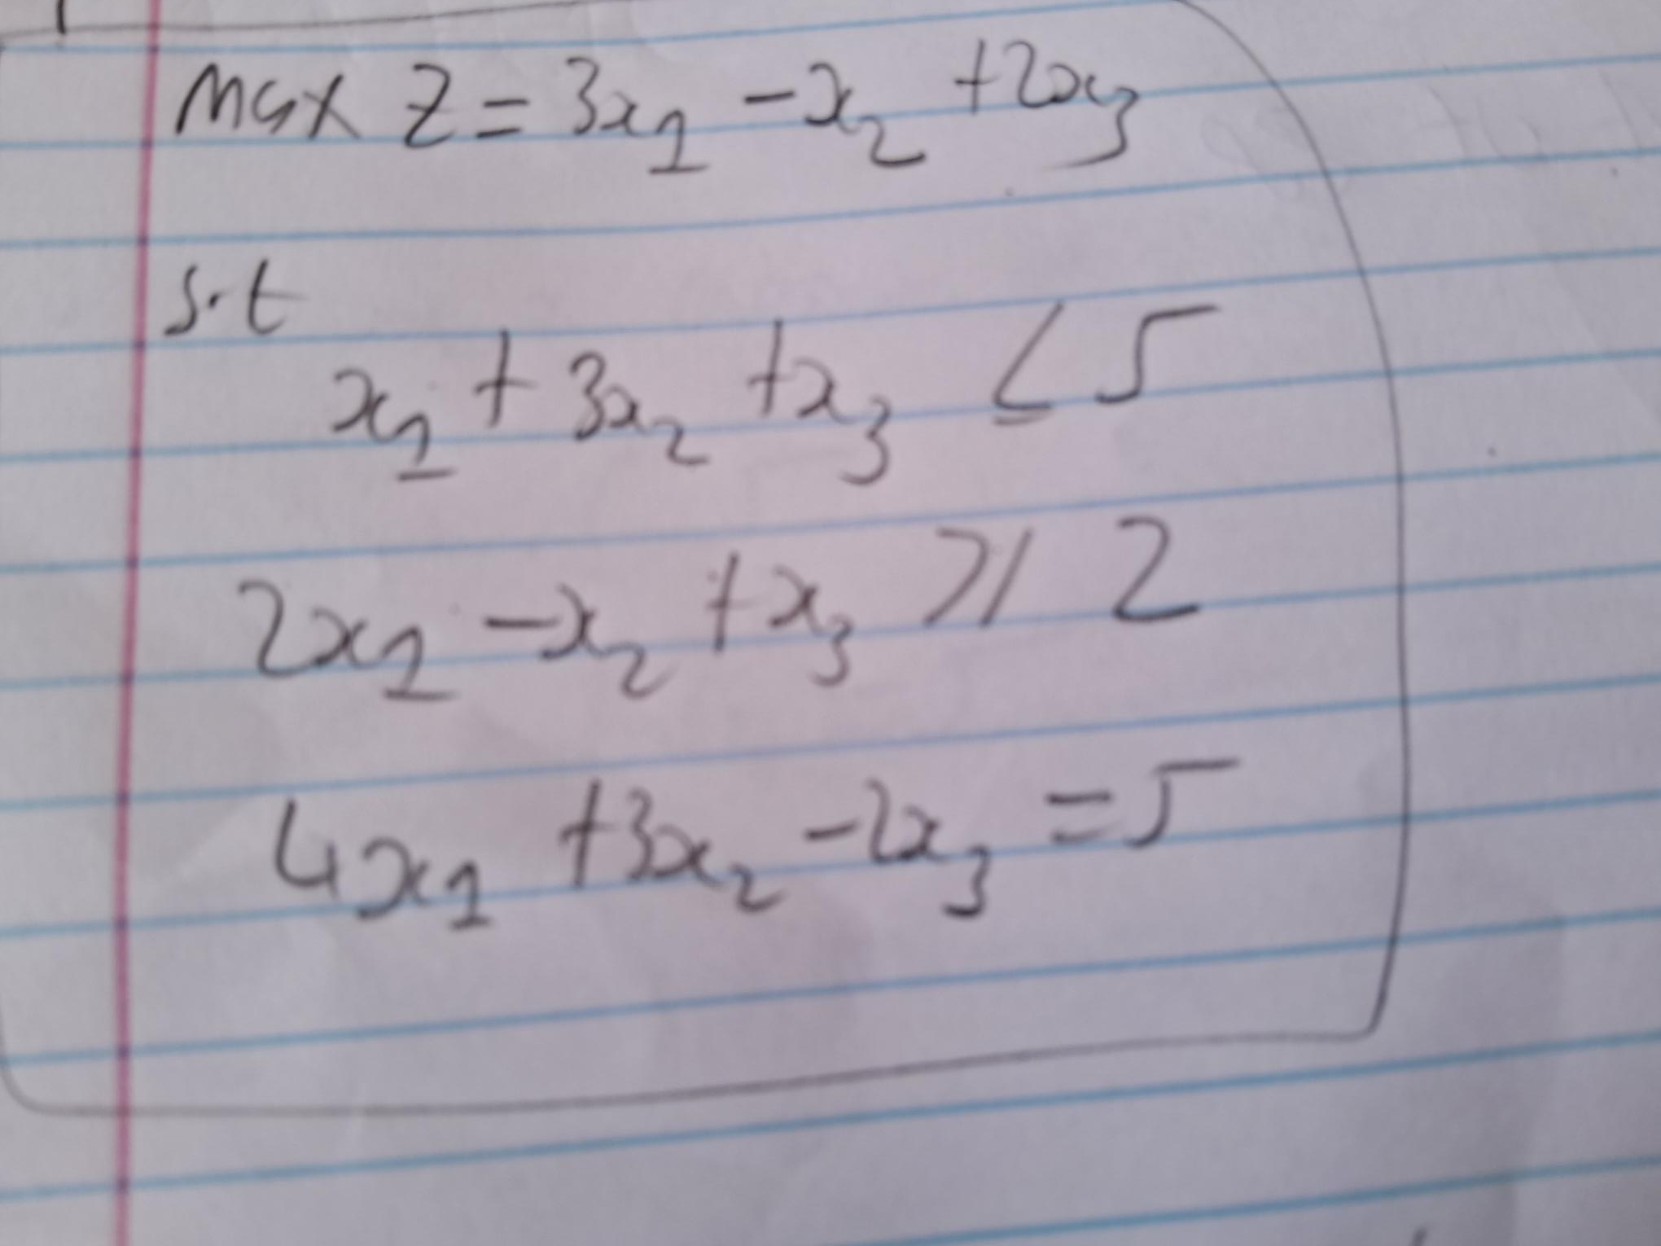
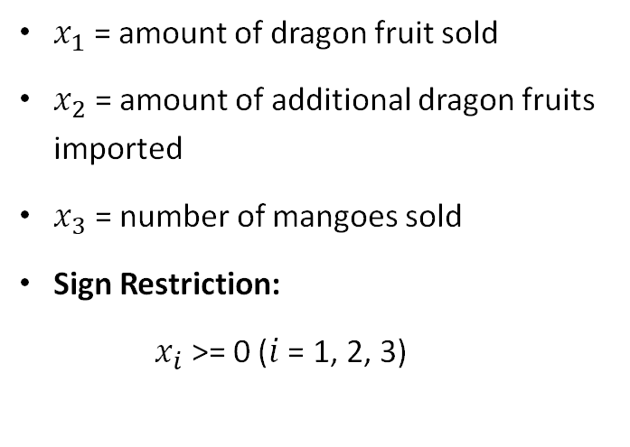
Mathematical Model
$x_{1}$ = amount of dragon fruit sold
$x_{2}$ = amount of additional dragon fruits imported
$x_{3}$ = number of mangoes sold
Sign Restriction:
$x_{i}$ >= 0 ($i$ = 1, 2, 3)
Constraint 1: Shipping Hours(can’t be in shipping for long)
Constraint 2: quantity of boxes being shipped
Constraint 3: quantity in each box

Slide 6
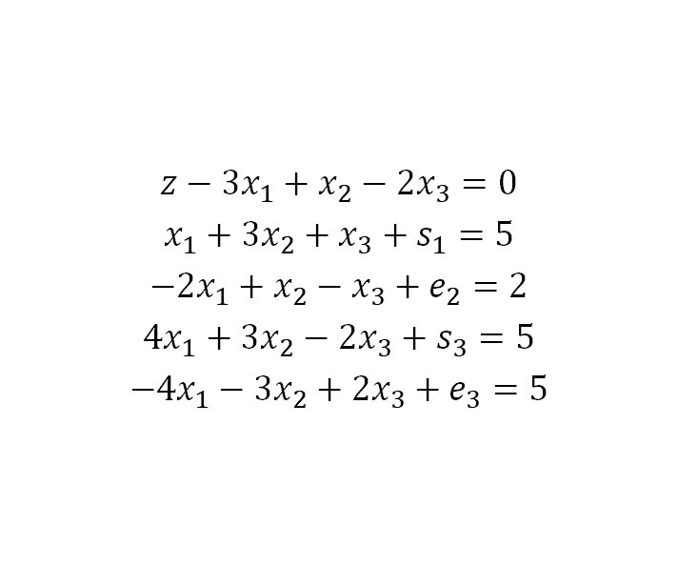
Dual Simplex Formulation (Canonical/Standard form)
$$z−{3x}_{1}+x_{2}−{2x}_{3}=0$$
$$x_{1}+{3x}_{2}+x_{3}+s_{1}=5$$
$$−{2x}_{1}+x_{2}−x_{3}+e_{2}=2$$
$${4x}_{1}+{3x}_{2}−{2x}_{3}+s_{3}=5$$
$${−4x}_{1}−{3x}_{2}+{2x}_{3}+e_{3}=5$$

Slide 7
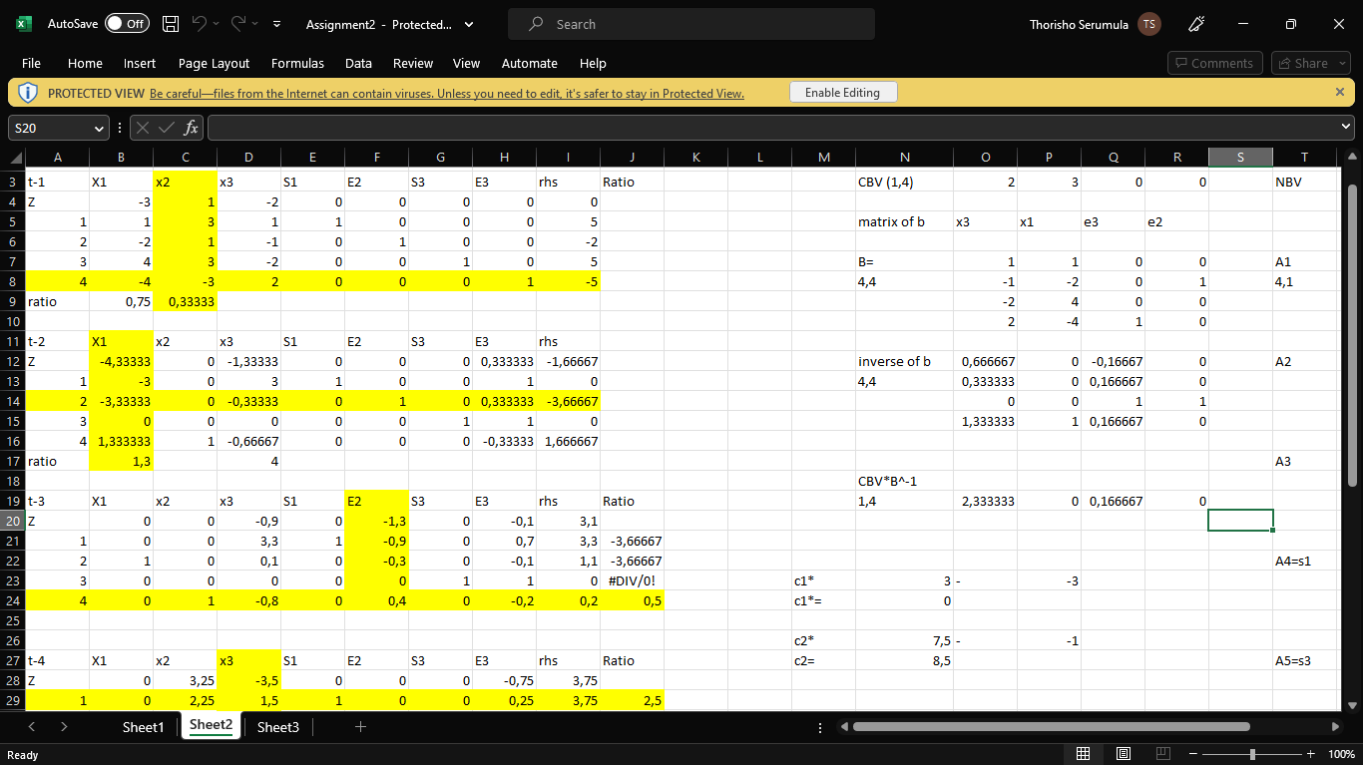
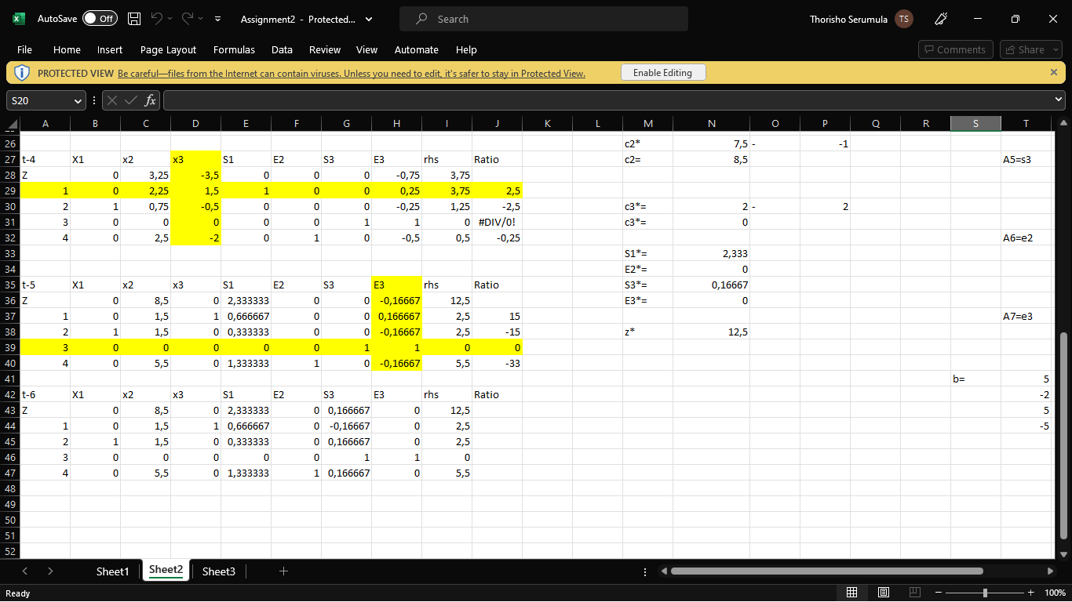
Dual Simplex Solved in Excel

Slide 8
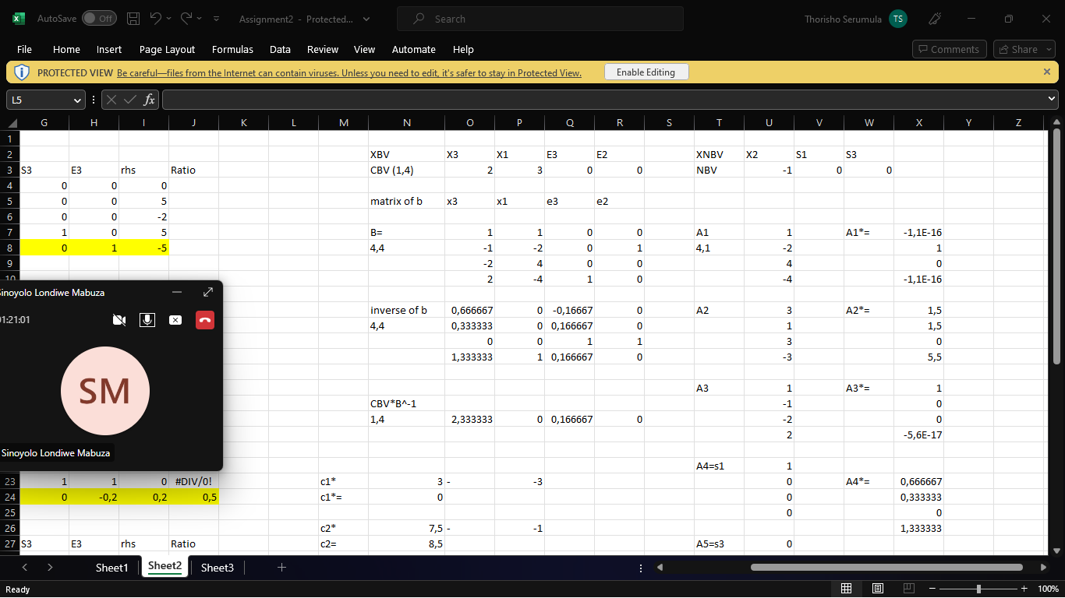
Linear Program Expressions

Slide 9
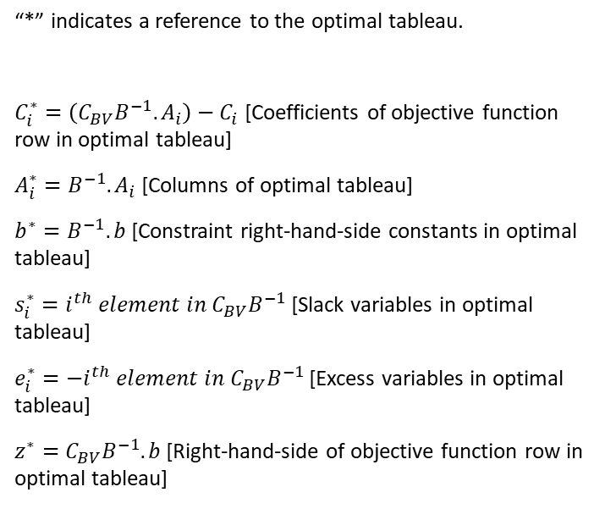
Optimal Tableau Calculation
“*” indicates a reference to the optimal tableau.
$C_{i}^{∗}=\left(C_{BV}B^{−1}.A_{i}\right)−C_{i}$ [Coefficients of objective function row in optimal tableau]
$A_{i}^{∗}=B^{−1}.A_{i}$ [Columns of optimal tableau]
$b^{∗}=B^{−1}.b$ [Constraint right-hand-side constants in optimal tableau]
$s_{i}^{∗}=i^{th} element in C_{BV}B^{−1}$ [Slack variables in optimal tableau]
$e_{i}^{∗}=−i^{th} element in C_{BV}B^{−1}$ [Excess variables in optimal tableau]
$z^{∗}=C_{BV}B^{−1}.b$ [Right-hand-side of objective function row in optimal tableau]

Slide 10
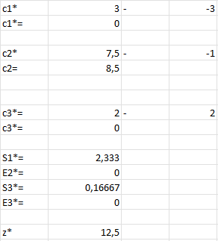
Optimal Tableau Calculation

Slide 11
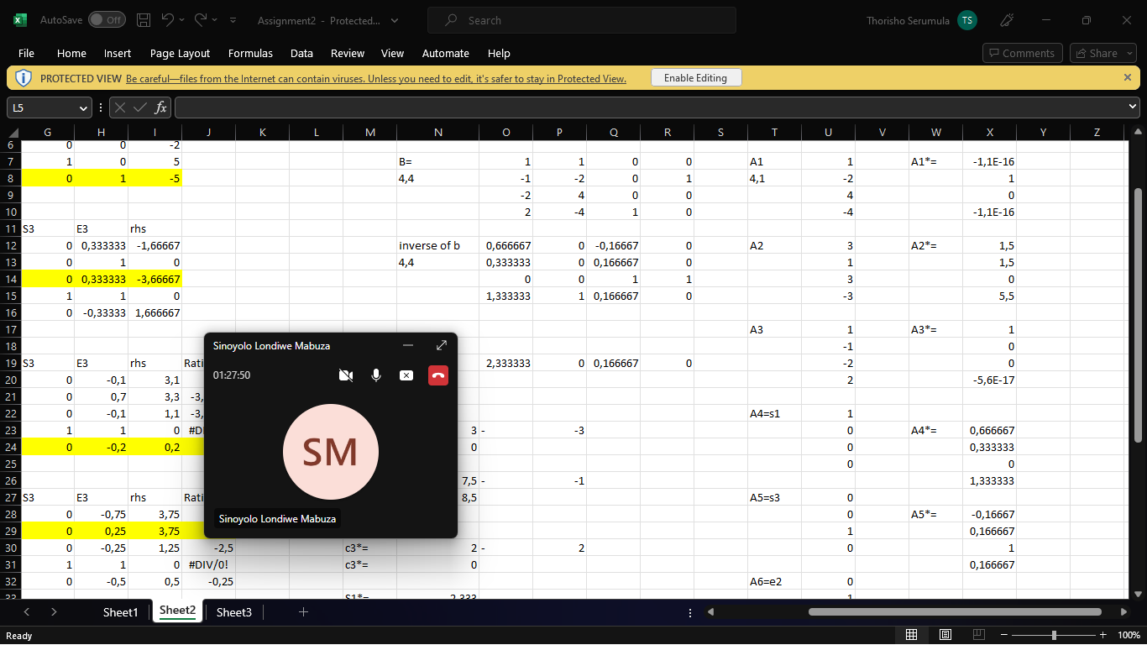
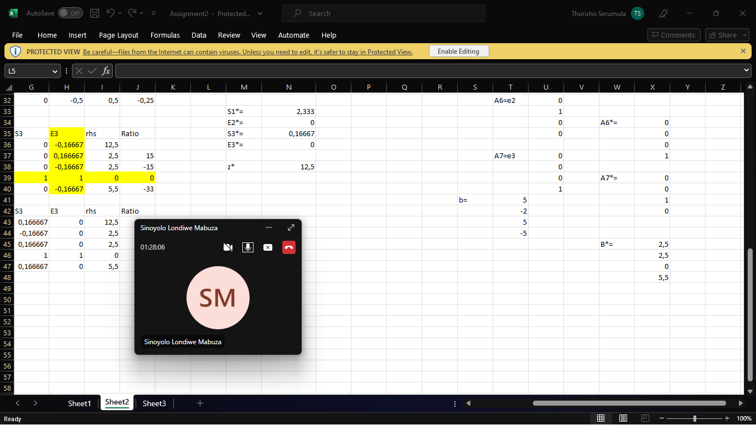
…continued

Slide 12

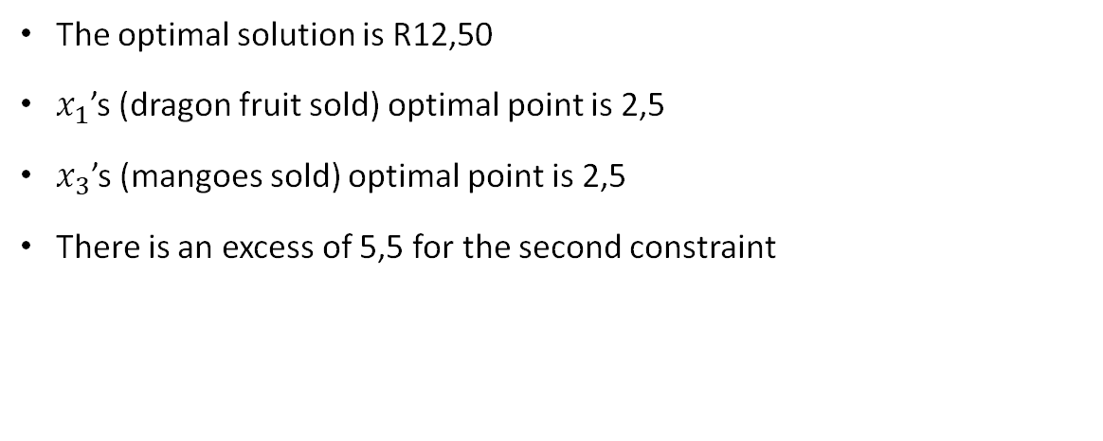
Conclusion
The optimal solution is R12,50
$x_{1}$’s (dragon fruit sold) optimal point is 2,5
$x_{3}$’s (mangoes sold) optimal point is 2,5
There is an excess of 5,5 for the second constraint

Slide 13

Thank you!

